Slide 2
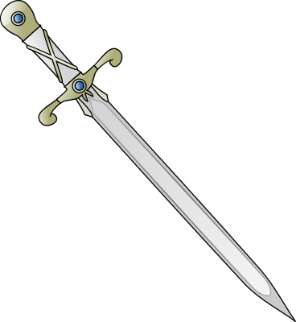
Wielding the Double-Edged Sword of JSON Schema
David Biesack
Chief API Officer, Apiture
Notes:
Hi! I'm Dave Biesack. I design APIs and developer experience at Apiture.
Apiture provides an API-enabled cloud platform that provides web and mobile banking to hundreds of financial institutions and their banking customers across the US
Today, I am going to talk about JSON Schema’s role in APIs and how to wield the double-edged sword of JSON Schema
Sword image: From https://openclipart.org/detail/22181

Slide 3

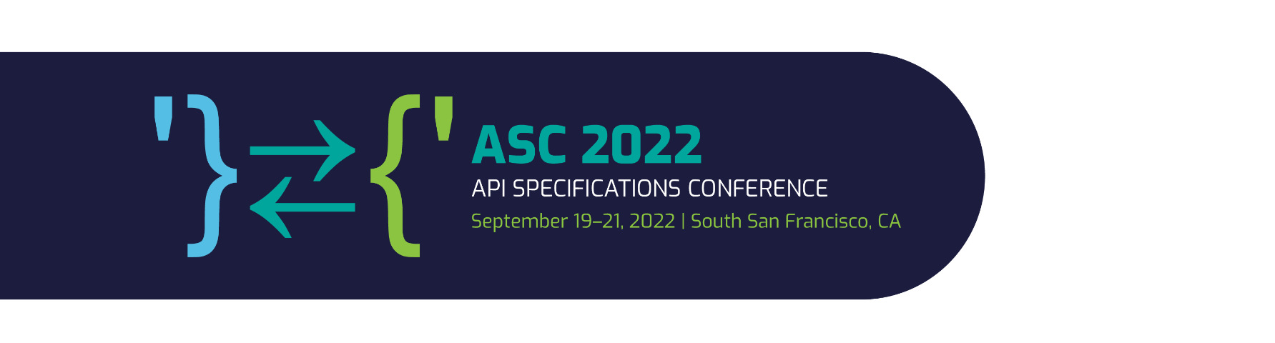
Software is Eating the World
-- Marc Andreessen
Notes:
Perhaps you’ve heard this quote from Marc Andreessen (co-author of the Mozilla browser, founder of Netscape and internet visionary).
"Software is Eating the World", at it's heart, is the essence of the API revolution:
all companies are becoming technologies companies,
and software and APIs are vehicles for delivering business value, supporting collaboration, integration, interoperability, and competition.

Slide 4
{ "JSON": "Eating the World" }
Notes:
As we know, over the past several years, JSON has emerged as the preferred transport message format for APIs.
It’s simple, clean, concise, very flexible, and easily read by computers and humans alike.
Both OpenAPI Specification and AsyncAPI Specification describe messages (and more) using JSON Schema

Slide 5
“JSON Schema is a vocabulary that allows you to annotate and validate JSON documents.”
-- json-schema.org
Notes:
In simpler terms:
JSON Schema describes your data
and JSON Schema validates data
These are the two edges of the double-edged sword of JSON Schema.
To be an API master, one must learn to wield and effectively use both edges of the sword blade.
Today, I’ll show some specific API design code using JSON Schema, and provide useful tips for wielding JSON Schema like a master.

Slide 6
The Finest Edge:
Validation

Slide 7
OWASP API Security Top Ten
API8:2019 Injection
“The API is vulnerable to injection flaws if data coming from external systems … is not validated … by the API.”
https://bit.ly/API8-2019
Notes:
Why does it JSON validation matter?
If you do not validate data from external systems, your API may be subject to injection flaws.
Validation is one of many practices to securing an API. It is not sufficient. But it is required.

Slide 8
JSON Schema excels at validation…
if you wield it correctly.
Tip: Wield it correctly

Slide 9


JSON Schema excels at validation…
if you wield it correctly.
Tip: Wield it correctly
The following is a valid JSON schema…
but not very useful:
true
Notes:
True is a valid JSON schema – it means that any valid JSON is accepted. So that degenerate case is not very useful in production APIs
Image: https://upload.wikimedia.org/wikipedia/commons/thumb/b/b2/Hand_of_a_Teenage_Boy.png/640px-Hand_of_a_Teenage_Boy.png

Slide 10
Honing the Validation Edge
Tip: Use Strong Constraints
type
minimum, exclusiveMinimum (numbers)
maximum, exclusiveMaximum (numbers)
minLength, maxLength, pattern, format (strings)
items, minItems, maxItems, uniqueItems (arrays)
required, properties, additionalProperties (objects)
Notes:
Instead of no validation or trivial/weak validation, apply stronger validation constraints
If `type` is omitted, the default is any type
`properties` does not “force” the schema to be `type: object`
`minimum`/`maximum` etc do not “force” the schema to be `type: number` etc.

Slide 11
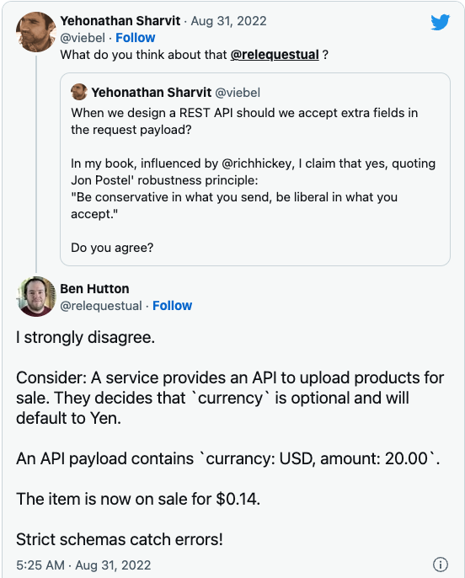
https://twitter.com/relequestual/status/1564907272387657728
Notes:
Bonus Tip: Also validate your response bodies and response headers against the JSON schema.
additionalProperties could be an entire presentation by itself….

Slide 12
Petstore Example
Notes:
I will spare you the dread of using Petstore examples, because….

Slide 13
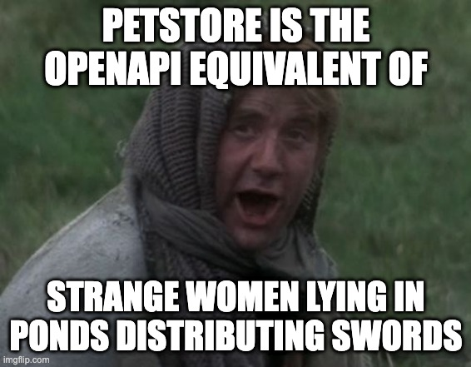
Petstore Example
Notes:
Petstore is the OpenAPI equivalent of strange women lying in ponds distributing swords

Slide 14
Example
List bank accounts matching one or more banking product types
GET /accounts?productType=savings|checking|cd
paths:
/accounts:
get:
parameters:
- name: productType
in: query
schema:
type: string
Lame!
Notes:
This weak validation schema forces the API developer to parse and validate the data.
It also does not inform the caller how to construct the query parameter

Slide 15
Example
List bank accounts matching one or more banking product types
GET /accounts?productType=savings|checking|cd
paths:
/accounts:
get:
parameters:
- name: productType
in: query
style: pipeDelimited
schema:
type: array
minItems: 1
uniqueItems: true
items:
$ref: '#/components/schemas/productType'
components:
schemas:
productType:
title: Product Type
description: The type of bank account.
type: string
enum:
- savings
- checking
- cd
- ira
- loan
- creditCard
Notes:
Here is a better constraint – query parameters can be strictly validated. Clients also know how to construct the query
The productType schema (a list of enumerated values) is useful in parameters and in in request/response body schemas, and thus is not embedded in the parameter schema but is instead referenced. This is an application of the DRY principle.

Slide 16
Tip: Use middleware (API Gateway) to automatically and unconditionally validate query parameters, request header parameters & request bodies against JSON Schema and automatically reject invalid calls
Notes:
Bonus Tip: Also validate your response bodies and response headers against the JSON schema.

Slide 17
Tip: Use middleware (API Gateway) to automatically and unconditionally validate query parameters, request header parameters & request bodies against JSON Schema and automatically reject invalid calls
Bonus Tip: Validate your response headers and bodies, too!
Notes:
Bonus Tip: Also validate your response bodies and response headers against the JSON schema.

Slide 18
Honing the Other Edge:
Data Modeling

Slide 19
Assertion: JSON Schema is primarily a data validation tool – validate that JSON data conforms to a given JSON Schema definition
Assertion: While JSON Schema is widely used for data modeling, that has not been its primary purpose or design intent

Slide 20
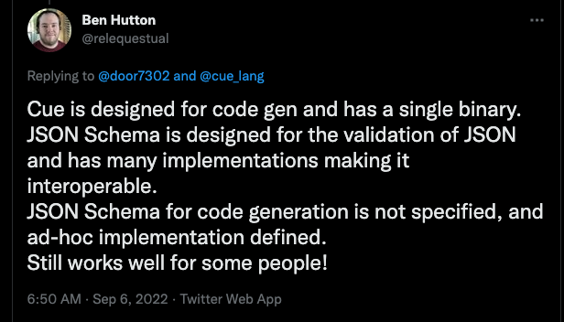
Notes:
Ben Hutton, JSON Schema spec lead:
JSON Schema is designed for the validation of JSON and has many implementations making it interoperable. JSON Schema for code generation is not specified, and ad-hoc implementation defined. Still works well for some people!
https://twitter.com/relequestual/status/1567102869475676162

Slide 21
Code generation tools convert JSON Schema data descriptions into types/classes/interfaces
OSS: openapi-generator, swagger-codegen, json-schema-to-typescript
Commercial tools like SwaggerHub, Apimatic

Slide 22
Example: Create/List/Patch/View Account-to-Account Transfers
components:
schemas:
transferFields:
type: object
properties:
schedule: …
amount: …
memo: …
sourceAccount: …
destinationAccount: …
newTransfer:
required: [ schedule, amount, sourceAccount, destinationAccount]
allOf:
- $ref: ../common/openapi.yaml#/components/schemas/abstractBody
- $ref: '#/components/schemas/transferFields'
transferFields is a mixin schema
Mixed in here
Notes:
We do not define any required properties in `transferFields` - only property schemas.
newTransfer isused as request body schema, and thus also mixes in the abstractBody schema

Slide 23
transferPatch:
allOf:
- $ref: ../common/openapi.yaml#/components/schemas/abstractBody
- $ref: '#/components/schemas/transferFields'
transferItem:
allOf:
- $ref: '#/components/schemas/transferFields'
- $ref: ../common/openapi.yaml#/components/schemas/timestampFields
- type: object
required: [ id, schedule, amount, state,
sourceAccount, destinationAccount, createdAt ]
properties:
id: …
state: …
transfer:
allOf:
- $ref: ../common/openapi.yaml#/components/schemas/abstractBody
- $ref: '#/components/schemas/transferItem'
- …
other mixin schemas
Notes:
transferPatch and transfer schemas are used for request/response body schemas, and thus also mixin the abstractBody schema
Transfer is composed of the abstractBody and the fields/constraints from transferItem, this the same required properties.

Slide 24
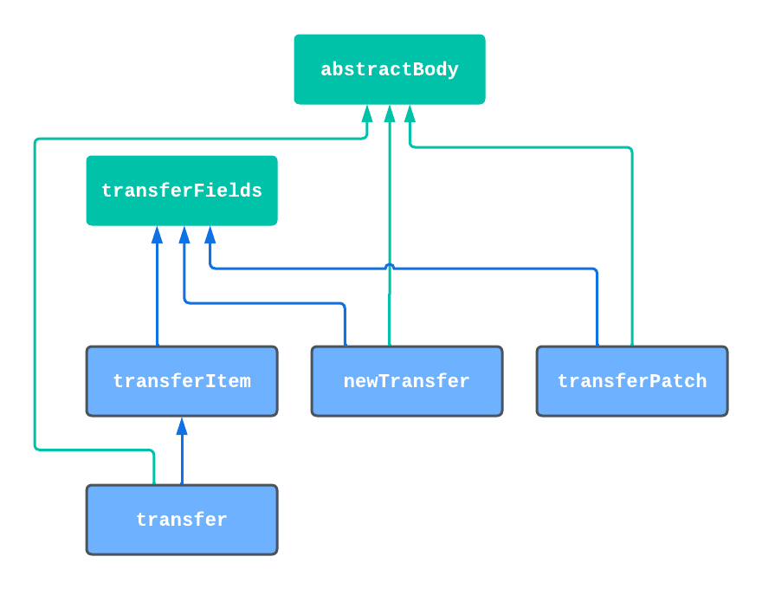
Transfer Schema Composition
Transfer Schema Composition
JSON Schema Mixins
Request and Response body
JSON Schemas
Notes:
transferItem is used in the collection response array – it is a short, summary representation
Transfer extends this, adds new detailed fields not needed in the collection response

Slide 25
Composition
allOf is for composition, not inheritance
Cannot override or replace validation
Tip: Use allOf for mixins or schema fragments
Notes:
Mixins allow:
DRY Principle– reusable (therefore consistent) property definitions
Schemas may have the same set of sharedproperties, but different required properties. I.e. fields may be required in a GET response but not required in a PATCH request body

Slide 26

Sharp Edges: Don’t Cut Yourself
Sharp Edges: Don’t Cut Yourself
anyOf
oneOf
not
if/then/else
Custom vocabularies
Custom formats
Tuple validation

Slide 27
Effect of allOf on Code Gen
Compare Effect of allOf on Code Generation
point:
title: A Point
description: A Point in 2-D space
type: object
allOf:
- $ref: '#/components/schemas/cartesianPoint'
- $ref: '#/components/schemas/polarPoint'
Notes:
Image: https://openclipart.org/detail/298687/pointing-finger-6b

Slide 28
…to use of oneOf on Code Generation
point:
title: A Point
description: A Point in 2-D space
type: object
oneOf: # (or anyOf; they have similar code gen output)
- $ref: '#/components/schemas/cartesianPoint'
- $ref: '#/components/schemas/polarPoint'

Slide 29
allOf:TypeScript
allOf: TypeScript
// TypeScript code for allOf:
export interface CartesianPoint {
x: number; // PolarPoint properties x, y are “inlined”
y: number;
}
export interface Point extends CartesianPoint {
rho: number;
theta: number;
}

Slide 30
oneOf:TypeScript
oneOf/anyOf: TypeScript
// TypeScript code for oneOf:
export interface CartesianPoint {
x: number; // PolarPoint properties x, y are “inlined”
y: number;
}
export interface PolarPoint {
rho: number;
theta: number;
}
export type Point = CartesianPoint | PolarPoint;

Slide 31
allOf:Java
allOf: Java
// Java code for allOf:
public class CartesianPoint {
private Double x = null;
private Double y = null;
}
public class Point extends CartesianPoint {
private Double rho = null; /* PolarPoint properties are “inlined” */
private Double theta = null;
}

Slide 32
oneOf:Java
oneOf/anyOf: Java
// Java code for oneOf:
public class CartesianPoint implements Point {
private Double x = null;
private Double y = null;
}
public class PolarPoint implements Point {
private Double rho = null;
private Double theta = null;
}
public interface Point { } // Must cast Point to CartesianPoint or PolarPoint

Slide 33
allOf:Go
allOf: Go
// Go code for allOf:
type Point struct {
Rho float64 `json:"rho"` // PolarPoint “inlined”
Theta float64 `json:"theta"`
X float64 `json:"x"` // CartesianPoint “inlined”
Y float64 `json:"y"`
}

Slide 34
oneOf:Go
oneOf/anyOf: Go
// Go code for oneOf:
type Point struct {
CartesianPoint
PolarPoint
}
type CartesianPoint struct {
X float64 `json:"x"`
Y float64 `json:"y"`
}
type PolarPoint struct {
Rho float64 `json:"rho"`
Theta float64 `json:"theta"`
}

Slide 35
code grid
TypeScript
Java
Go
// Go code for oneOf:
type Point struct {
CartesianPoint
PolarPoint
}
type CartesianPoint struct {
X float64 `json:"x"`
Y float64 `json:"y"`
}
type PolarPoint struct {
Rho float64 `json:"rho"`
Theta float64 `json:"theta"`
}
allOf
oneOf
Notes:
With allOf, note how first schema maps to “extends”, and second schema results in in-lining:
TypeScript: interface Point extends CartesianPoint
Java: class Point extends CartesianPoint

Slide 36
Tips
Try code generation against multiple languages, not just JavaScript/TypeScript
Mix dynamic and strongly typed languages
Notes:
I avoid use of OpenAPI discriminator, although some may find it a useful way to use this OAS vocabulary. The downside is that not all tools that understand JSON schema also understand the OAS vocabulary. Some do.

Slide 37
Modeling polymorphism
Tip: Use typed objects and a type property for Run-Time Type Identification
point2D:
type: object
required: [ type ]
properties:
type:
type: string
enum: [ cartesian, polar ]
cartesian:
$ref: '#/components/schemas/cartesianPoint'
polar:
$ref: '#/components/schemas/polarPoint'
Run-Time Type Identification (RTTI)
Notes:
I avoid use of OpenAPI discriminator, although some may find it a useful way to use this OAS vocabulary. The downside is that not all tools that understand JSON schema also understand the OAS vocabulary. Some do.

Slide 38
CodeGen Effects of Unnamed Inline Schemas
Less than ideal name
// TypeScript:
export interface Point2DType {
type: Point2DType.TypeEnum;
cartesian?: CartesianPoint;
polar?: PolarPoint;
}
export namespace Point2DType {
export type TypeEnum =
'cartesian' | 'polar';
export const TypeEnum = {
Cartesian: 'cartesian' as TypeEnum,
Polar: 'polar' as TypeEnum
};
}
// Go:
type Point2D struct {
Type_ string `json:"type,omitempty"`
// no strong type constraints
Cartesian *CartesianPoint
`json:"cartesian,omitempty"`
Polar *PolarPoint
`json:"polar,omitempty"`
}

Slide 39
OpenAPI discriminator
Tip: Try this at home: observe how OpenAPI discriminator affects code generation
TypeScript
Java
Go
Rust
…
Notes:
I avoid use of OpenAPI discriminator, although some may find it a useful way to use this OAS vocabulary. The downside is that not all tools that understand JSON schema also understand the OAS vocabulary. Some do.
See also the ASC 2022 talk about JSON Schema Vocabilary

Slide 40
Object Modeling with Named Schemas
Tip: Avoid inline (unnamed) object & enum schemas
point2D:
type: object
required: [ type ]
properties:
type:
$ref: '#/components/schemas/pointType'
pointType:
type: string
enum: [ cartesian, polar ]
Notes:
I avoid use of OpenAPI discriminator, although some may find it a useful way to use this OAS vocabulary. The downside is that not all tools that understand JSON schema also understand the OAS vocabulary. Some do.

Slide 41
CodeGen Effects of Using Named Schemas
// Typescript:
export type PointType = 'cartesian' | 'polar';
export const PointType = {
Cartesian: 'cartesian' as PointType,
Polar: 'polar' as PointType
};
export interface Point2D {
type: PointType;
cartesian?: CartesianPoint;
polar?: PolarPoint;
}
// point.type = PointType.polar
// Go:
type Point2D struct {
Type_ *PointType `json:"type,omitempty"`
Cartesian *CartesianPoint
`json:"cartesian,omitempty"`
Polar *PolarPoint
`json:"polar,omitempty"`
}
type PointType string
const (
CARTESIAN_PointType PointType = "cartesian"
POLAR_PointType PointType = "polar"
)
// point.type = PointType.POLAR_PointType
Notes:
Note that `Type` is a keyword in Go, so the JSON Schema property name type becomes Type_ https://go.dev/ref/spec#Keywords
But even so, the definition of the type PointType for Go does not constrain the values – it is still just a string. You won’t get IDE code completion help. This is where JSON Schema validation must be used to enforce the runtime enum constraint.

Slide 42
Future Work:
Data Modeling

Slide 43
vocab-idl
Use JSON Schema vocabulary to define a data Interface Definition Language
  For example, map JSON Schema to
    Database DDL
    Data structures in Java, TypeScript, Go, Python, etc
  github.com/json-schema-org/vocab-idl
  #vocab-idl in the JSON Schema slack, json-schema.org/slack

Slide 44
sig-codegen
OpenAPI Initiative Discord Special Interest Group forum to discuss code generation for OpenAPI Specification
Contact me or your favorite OAS member for an invitation

Slide 45
Related sessions and projects
Ben Hutton: Two ASC’22 talks
Jason Desrosiers: ASC’22 on JSON Schema vocabularies
github.com/json-schema-org/vocab-idl
github.com/terryweiss/jsm
github.com/notEthan/jsi
github.com/bcherny/json-schema-to-typescript
github.com/DavidBiesack/JSON-Schema-ASC-2022

Slide 46
Stay Safe!
github.com/davidbiesack
twitter.com/davidbiesack
www.linkedin.com/in/davidbiesack
Notes:
Feel free to contact me to further the discussion of wielding the double-edged sword of JSON Schema

